Slide 1


Computer Networks
Lectures (Chapter3)
Transport Layer
Subhan Ullah, PhD
subhan.ullah@nu.edu.pk
BS(Computer Science) Fall-2022

Slide 2
Transport layer: overview
Our goal:
understand principles behind transport layer services:
multiplexing, demultiplexing
reliable data transfer
flow control
congestion control
learn about Internet transport layer protocols:
UDP: connectionless transport
TCP: connection-oriented reliable transport
TCP congestion control

Slide 3

Chapter 3: roadmap
Transport-layer services
Multiplexing and demultiplexing
Connectionless transport: UDP
Principles of reliable data transfer
Connection-oriented transport: TCP
segment structure
reliable data transfer
flow control
connection management
Principles of congestion control
TCP congestion control

Slide 4
TCP: overview RFCs: 793,1122, 2018, 5681, 7323
point-to-point:
one sender, one receiver
reliable, in-order byte stream:
no “message boundaries"
full duplex data:
bi-directional data flow in same connection
MSS: maximum segment size
cumulative ACKs
pipelining:
TCP congestion and flow control set window size
connection-oriented:
handshaking (exchange of control messages) initializes sender, receiver state before data exchange
flow controlled:
sender will not overwhelm receiver
Notes:
Typical MSS is 1460 bytes

Slide 5
TCP sequence numbers, ACKs
outgoing segment from sender
Sequence numbers:
byte stream “number” of first byte in segment’s data
source port #
dest port #
sequence number
acknowledgement number
rwnd
checksum
urg pointer
window size
N
Acknowledgements:
seq # of next byte expected from other side
cumulative ACK
sender sequence number space
sent
ACKed
sent, not-yet ACKed
(“in-flight”)
usable
but not
yet sent
not
usable
Q: how receiver handles out-of-order segments
A: TCP spec doesn’t say, - up to implementor
outgoing segment from receiver
source port #
dest port #
sequence number
acknowledgement number
A
rwnd
checksum
urg pointer

Slide 6
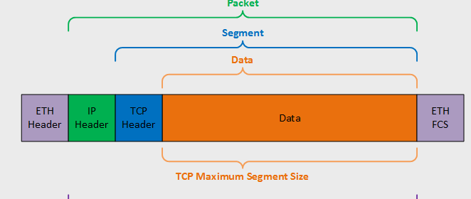
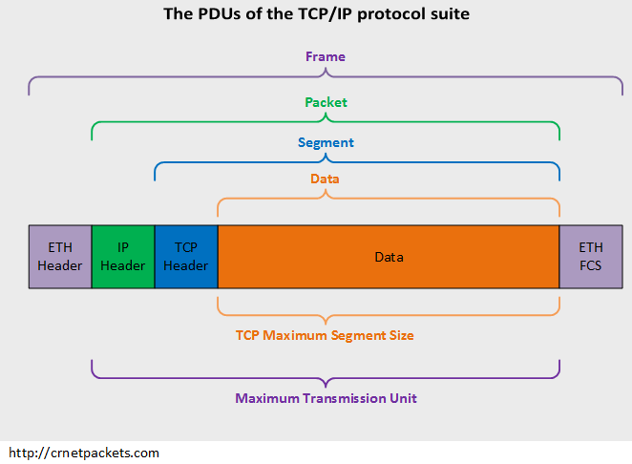
MSS and MTU
The maximum amount of data in a segment is limited by the maximum segment size (MSS)
The MSS is typically set by first determining (the so-called maximum transmission unit, MTU)
MSS+ TCP/IP header when encapsulated in an IP datagram) will fit into a single link-layer frame
Notes:
the length of the largest link-layer frame that can be sent by the local sending host
FCS: Frame check sequence
ETH: Ethernet

Slide 7
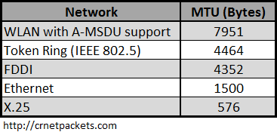
MSS and MTU
The MSS limits the maximum size of a segment’s data field
It is more or less a physical limit
It is specified for each link separately
MTU reduction can occur elsewhere in the communication path
Notes:
Fiber Distributed Data Interface (FDDI)
Fiber Distributed Data Interface is a standard for data transmission in a local area network. It uses optical fiber as its standard underlying physical medium, although it was also later specified to use copper cable, in which case it may be called CDDI, standardized as TP-PMD, also referred to as TP-DDI.
MAC Service Data Unit (MSDU)
X.25 is an ITU-T standard protocol suite for packet-switched data communication in wide area networks. It was originally defined by the International Telegraph and Telephone Consultative Committee in a series of drafts and finalized in a publication known as The Orange Book in 1976.

Slide 8
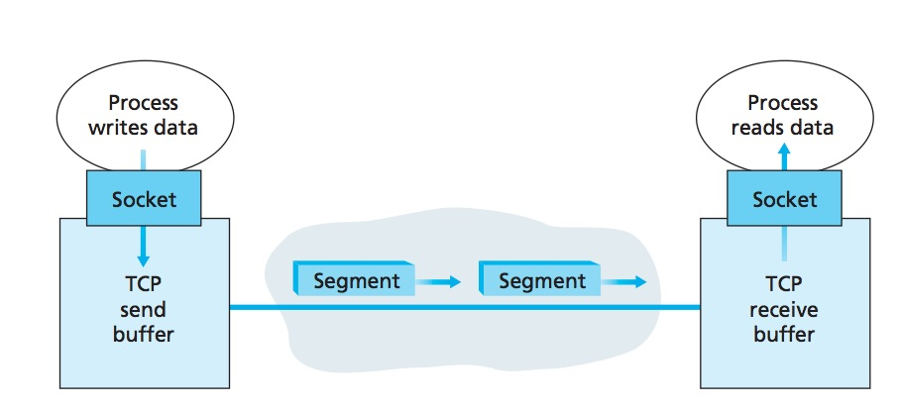
TCP Send/Receive buffers
The client process passes a stream of data through the socket
Once the data passes through the Socket, the data is in the hands of TCP running in the client
TCP directs this data to the connection’s send buffer, which is one of the buffers that is set aside during the initial three-way handshake
From time to time, TCP will grab chunks of data from the send buffer and pass the data to the network layer

Slide 9
TCP connection
TCP connection consists of
Buffers and variables
a socket connection to a process in one host, and another set of buffers, variables, and a socket connection to a process in another host
Nothing is stored in the network elements (routers, switches, and repeaters) between the hosts

Slide 10
TCP segment structure
32 bits
source port #
dest port #
segment seq #: counting bytes of data into bytestream (not segments!)
ACK: seq # of next expected byte; A bit: this is an ACK
sequence number
acknowledgement number
length (of TCP header)
head
len
not
used
A
P
S
receive window
flow control: # bytes receiver willing to accept
C
E
U
R
F
Internet checksum
checksum
Urg data pointer
options (variable length)
C, E: congestion notification
TCP options
application
data
(variable length)
data sent by application into TCP socket
RST, SYN, FIN: connection management

Slide 11
TCP segment structure (Flags)
PUSH Flag
The sending application informs TCP that data should be sent immediately
The PSH flag in the TCP header informs the receiving host that the data should be pushed up to the receiving application immediately
Urgent Data
DEL or CTRL-C to break off a remote computation
Use URGENT flag – Transmit everything right now
Receiving application is interrupted
Notes:
PSH and the PUSH function
When you send data, your TCP buffers it. So if you send a character it won't send it immediately but wait to see if you've got more. But maybe you want it to go straight on the wire: this is where the PUSH function comes in. If you PUSH data your TCP will immediately create a segment (or a few segments) and push them.
But the story doesn't stop here. When the peer TCP receives the data, it will naturally buffer them it won't disturb the application for each and every byte. Here's where the PSH flag kicks in. If a receiving TCP sees the PSH flag it will immediately push the data to the application.

Slide 12
Sequence Numbers
TCP views data as an unstructured, but ordered, stream of bytes
Sequence numbers are over the stream of transmitted bytes and not over the series of transmitted segments
The sequence number for a segment is therefore the byte-stream number of the first byte in the segment
A process in Host A wants to send a stream of data to a process in Host B
Example: The TCP in Host A will implicitly number each byte in the data stream
For a file consisting of 500,000 bytes,
MSS being 1,000 bytes, and that the first byte of the data stream is numbered 0
TCP constructs 500 segments out of the data stream

Slide 13
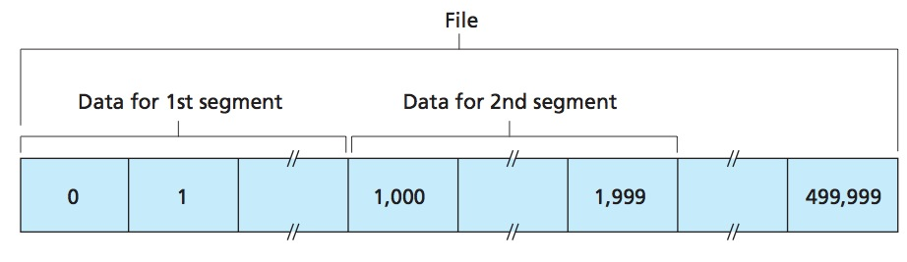
TCP Sequence Numbers
The first segment gets assigned sequence number 0, the second segment gets assigned sequence number 1,000, the third segment gets assigned sequence number 2,000, and so on

Slide 14
Full duplex
TCP is full-duplex, so that Host A may be receiving data from Host B while it sends data to Host B (as part of the same TCP connection).
Data for B
A
Data for A
ACK
B
ACK
Notes:
Simplex, half duplex and full duplex

Slide 15
Acknowledgment numbers (Example)
Host A has received all bytes numbered 0 through 535 from B
Host A has also received another segment containing bytes 900 through 1,000
For some reason Host A has not yet received bytes 536 through 899
What does Host A put in the acknowledgment number field of the next segment it sends to B?
A’s next segment to B will contain 536 in the acknowledgment
number field

Slide 16
Another example
A sends a segment to B, what would B put in the Ack sequence number in the next segment it sends to A?
next byte Host B is expecting from Host A
A sends a segment to B, what would A put in the Ack sequence number in the next segment it sends to B?
next byte Host A is expecting from Host B
Host A has received all bytes numbered 0 through 535 from B
Host A is waiting for byte 536 and all the subsequent bytes in Host B’s data stream
What does Host A put in the acknowledgment number field of the next segment it sends to B?
Host A puts 536 in the acknowledgment number field of the segment it sends to B

Slide 17
Out of order segments
TCP only acknowledges bytes up to the first missing byte in the stream, TCP is said to provide cumulative acknowledgments
For out of order segments it can either discard them or buffer them (the approach actually taken in practice)

Slide 18
The seg/ack numbers base
we assumed that the initial sequence number was zero
In truth, both sides of a TCP connection randomly choose an initial sequence number
Why?
This is done to minimize the possibility of a segment that is still present in the network from an earlier, already-terminated connection between two hosts is mistaken for a valid segment in a later connection between these same two hosts (which also happen to be using the same port numbers as the old connection)
Notes:
This is done to minimize the possibility that a segment that is still present in the network from an earlier, already-terminated connection between two hosts is mistaken for a valid segment in a later connection between these same two hosts (which also happen to be using the same port numbers as the old connection)

Slide 19

TCP sequence numbers, ACKs
Host A
Host B
User types‘C’
Seq=42, ACK=79, data = ‘C’
host ACKs receipt of‘C’, echoes back ‘C’
Seq=79, ACK=43, data = ‘C’
host ACKs receipt of echoed ‘C’
Seq=43, ACK=80
simple telnet scenario
Notes:
Section E and F covered
Section D covered: 11-18-2021
The key thing to note here is that the ACK number (43) on the B-to-A segment is one more than the sequence number (42) on the A-to-B segment that triggered that ACK…
Similarly, the ACK number (80) on the last A-to-B segment is one more than the sequence number (79) on the B-to-A segment that triggered that ACK
Telnet IP address
Bidirectional and using port number 23.
To check the port on a remote system: telnet IP-address port# i.e., telnet 192.168.10.10 443

Slide 20
TCP round trip time, timeout
Q: how to set TCP timeout value?
longer than RTT, but RTT varies!
too short: premature timeout, unnecessary retransmissions
too long: slow reaction to segment loss
Q: how to estimate RTT?
SampleRTT:measured time from segment transmission until ACK receipt
ignore retransmissions
SampleRTT will vary, want estimated RTT “smoother”
average several recent measurements, not just current SampleRTT

Slide 21
TCP round trip time, timeout
EstimatedRTT = (1- α)*EstimatedRTT + α*SampleRTT
exponential weighted moving average (EWMA)
influence of past sample decreases exponentially fast
typical value: α = 0.125
RTT: gaia.cs.umass.edu to fantasia.eurecom.fr
RTT (milliseconds)
sampleRTT
EstimatedRTT
time (seconds)
Notes:
This is how TCP re-computes the estimated RTT each time a new SampleRTT is taken.
The process is knows as an exponeitally weighted moving average, shown by the equation here.
<say it>
Where alpha reflects the influence of the most recent measurements on the estimated RTT; a typical value of alpha used in implementaitons is .125
The graph at the bottom show measured RTTs beween a host in the Massachusetts and a host in France, as well as the estimated, “smoothed” RTT

Slide 22

TCP round trip time, timeout
timeout interval: EstimatedRTT plus “safety margin”
large variation in EstimatedRTT: want a larger safety margin
TimeoutInterval = EstimatedRTT + 4*DevRTT
estimated RTT
“safety margin”
DevRTT: EWMA of SampleRTT deviation from EstimatedRTT:
DevRTT = (1-β)*DevRTT + β*|SampleRTT-EstimatedRTT|
(typically, β = 0.25)
Notes:
Given this value of the estimated RTT, TCP computes the timeout interval to be the estimated RTT plus a “safety margin”
And the intuition is that if we are seeing a large variation in SAMPLERTT – the RTT estimates are fluctuating a lot - then we’ll want a larger savety margin
So TCP computes the Timeout interval to be the Estimated RTT plus 4 times a measure of deviation in the RTT.
The deviation in the RTT is computed as the eWMA of the difference between the most recently measured SampleRTT from the Estimated RTT

Slide 23
TCP Sender (simplified)
event: data received from application
create segment with seq #
seq # is byte-stream number of first data byte in segment
start timer if not already running
think of timer as for oldest unACKed segment
expiration interval: TimeOutInterval
event: timeout
retransmit segment that caused timeout
restart timer
event: ACK received
if ACK acknowledges previously unACKed segments
update what is known to be ACKed
start timer if there are still unACKed segments
Notes:
Given these details of TCP sequence numbers, acks, and timers, we can now describe the big picture view of how the TCP sender and receiver operate
You can check out FSMs in book; let’s just give an English text description here and let’s start with the sender.

Slide 24
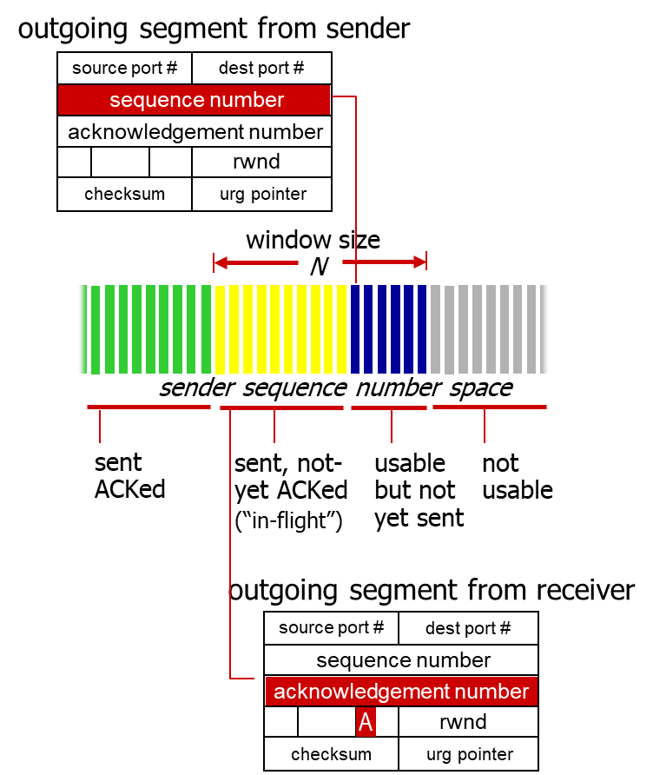
TCP sender (simplified)
data received from application above
create segment, seq. #: NextSeqNum
pass segment to IP (i.e., “send”)
NextSeqNum = NextSeqNum + length(data)
if (timer currently not running)
start timer
Λ
NextSeqNum = InitialSeqNum
SendBase = InitialSeqNum
wait
for
event
timeout
retransmit not-yet-acked segment with smallest seq. #
start timer
ACK received, with ACK field value y
if (y > SendBase) {
SendBase = y
/* SendBase–1: last cumulatively ACKed byte */
if (there are currently not-yet-acked segments)
start timer
}

Slide 25
TCP Receiver: ACK generation [RFC 5681]
Event at receiver
arrival of in-order segment with
expected seq #. All data up to
expected seq # already ACKed
arrival of in-order segment with
expected seq #. One other
segment has ACK pending
arrival of out-of-order segment
higher-than-expect seq. # .
Gap detected
arrival of segment that
partially or completely fills gap
TCP receiver action
delayed ACK. Wait up to 500ms
for next segment. If no next segment,
send ACK
immediately send single cumulative
ACK, ACKing both in-order segments
immediately send duplicate ACK,
indicating seq. # of next expected byte
immediate send ACK, provided that
segment starts at lower end of gap
Notes:
Rather than immediately ACKnowledge this segment, many TCP implementations will wait for half a second for another in-order segment to arrive, and then generate a single cumulative ACK for both segments – thus decreasing the amount of ACK traffic. The arrival of this second in-order segment and the cumulative ACK generation that covers both segments is the second row in this table.

Slide 26
TCP: retransmission scenarios
Host A
Host B
Host A
Host B
SendBase=92
Seq=92, 8 bytes of data
Seq=92, 8 bytes of data
timeout
timeout
Seq=100, 20 bytes of data
ACK=100
X
ACK=100
ACK=120
Seq=92, 8 bytes of data
Seq=92, 8
bytes of data
SendBase=100
send cumulative
ACK for 120
SendBase=120
ACK=100
ACK=120
SendBase=120
lost ACK scenario
premature timeout
Notes:
To cement our understanding of TCP reliability, let’s look a a few retransmission scenarios
In the first case a TCP segments is transmited and the ACK is lost, and the TCP timeout mechanism results in another copy of being transmitted and then re-ACKed a the sender
In the second example two segments are sent and acknowledged, but there is a premature timeout e for the first segment, which is retransmitted. Notet that when this retransmitted segment is received, the receiver has already received the first two segments, and so resends a cumulative ACK for both segments received so far, rather than an ACK for just this fist segment.

Slide 27
TCP: retransmission scenarios
Host A
Host B
Seq=92, 8 bytes of data
Seq=100, 20 bytes of data
ACK=100
X
ACK=120
Seq=120, 15 bytes of data
cumulative ACK covers for earlier lost ACK
Notes:
Section F covered: 19-11-2021
And in this last example, two segments are again transmitted, the first ACK is lost but the second ACK, a cumulative ACK arrives at the sender, which then can transmit a third segment, knowing that the first two have arrived, even though the ACK for the first segment was lost

Slide 28
Modified TCP – Doubling Timeout Interval
Whenever the timeout event occurs it sets the next timeout interval to twice the previous value,
rather than deriving it from the last EstimatedRTT and DevRTT
However, in case of other two events (app data received or ACK received), it is derived
It also provides a limited form of congestion control
Timer expiration due to congestion
It is better to wait rather than keep sending
Notes:
For example, suppose TimeoutInterval associated with the oldest not yet acknowledged segment is .75 sec when the timer first expires. TCP will then retransmit this segment and set the new expiration time to 1.5 sec. If the timer expires again 1.5 sec later, TCP will again retransmit this segment, now setting the expiration time to 3.0 sec.

Slide 29
Modified TCP – Fast Retransmit
Timeout-triggered retransmissions can take long
Duplicate ACKs can help sender to detect packet loss
A duplicate ACK is an ACK that reacknowledges a segment for which the sender has already received an earlier acknowledgment.
When it is sent/received?

Slide 30

TCP fast retransmit
Host A
Host B
TCP fast retransmit
if sender receives 3 additional ACKs for same data (“triple duplicate ACKs”), resend unACKed segment with smallest seq #
likely that unACKed segment lost, so don’t wait for timeout
Seq=92, 8 bytes of data
Seq=100, 20 bytes of data
X
ACK=100
timeout
ACK=100
ACK=100
Receipt of three duplicate ACKs indicates 3 segments received after a missing segment – lost segment is likely. So retransmit!
ACK=100
Seq=100, 20 bytes of data
Notes:
Let’s wrap up our study of TCP reliability by discussing an optimization to the original TCP known as TCP fast retransmit,
Take a look at this example on the right where 5 segments are transmitted and the second segment is lost. In this case the TCP receiver sends an ACK 100 acknowledging the first received segment.
When the third segment arrives at the receiver, the TCP receiver sends another ACK 100 since the second segment has not arrived. And similarly for the 4th and 5th segments to arrive.
Now what does the sender see? The sender receives the first ACK 100 it has been hoping for, but then three additional duplicate ACK100s arrive. The sender knows that somethings’ wrong – it knows the first segment arrived at the receiver but three later arriving segments at the receiver – the ones that generated the three duplicate ACKs – we received correctly but were not in order. That is, that there was a missing segment at the receiver when each of the three duplicate ACK were generated.
With fast retransmit, the arrival of three duplicate ACK causes the sender to retransmit its oldest unACKed segment, without waiting for a timeout event. This allows TCP to recover more quickly from what is very likely a loss event
specifically that the second segment has been lost, since three higher -numbered segments were received

Slide 31
TCP uses Go-Back-N or Selective Repeat?
Go-Back-N?
TCP acknowledgments are cumulative
TCP sender need only maintain SendBase and NextSeqNum
So, What do you say?
Selective Repeat?
If n lost, only retransmit n
Receiver would buffer out of order segments
So? What do you say?
It can be considered as an hybrid of both Go-Back-N and Selective Repeat
Notes:
there are some striking differences between TCP and Go-Back-N. Many TCP implementations will buffer correctly received but out-of-order segments [Stevens 1994].
would retransmit at most one segment, namely, segment n.
Moreover, TCP would not even retransmit segment n if the acknowledgment for segment n + 1 arrived before the timeout for segment n.

Slide 32


Thank You All
☺
?
A note on the origin of these ppt slides:
All material copyright 1996-2020 J.F Kurose and K.W. Ross, All Rights Reserved
These slides are freely provided by the book authors and it represents a lot of work on their part. We would like to thank J.F Kurose and K.W. Ross.
Transport Layer: 3-150
Notes:
Section F and G ended

